Slide 1
R Shiny for Operations
Instructor: Geoffrey Arnold

Slide 2
Basic Concepts of Shiny apps
They’re all just functions

Slide 3
Examples
App
https://gallery.shinyapps.io/lego-viz/
Shiny Dashboard
https://gallery.shinyapps.io/087-crandash/
Flexdashboard
https://pittsburghpa.shinyapps.io/dashburgh/
Map:
https://pittsburghpa.shinyapps.io/BurghsEyeView

Slide 4

Two Basic Parts of the function
UI – User Interface
Builds the webpage
Can be done in R code OR HTML
Server
Generates all reactive content
Can be used to change portions of UI

Slide 5
Basic Concepts of Shiny apps
Building a User Interface

Slide 6
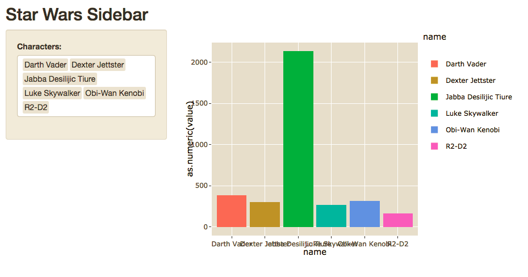
Sidebar Layout

Slide 7
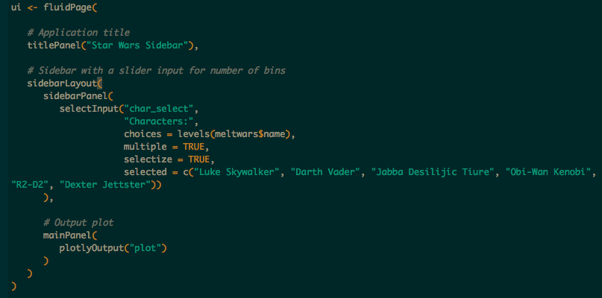

Slide 8
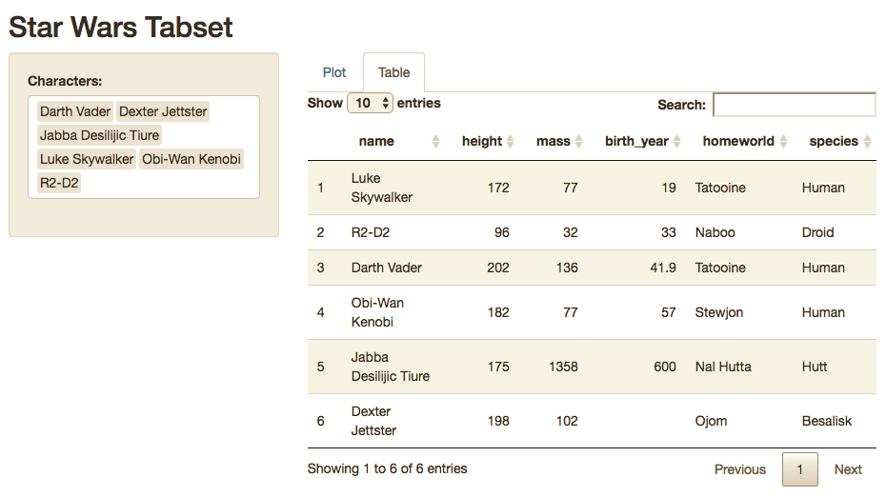
Sidebar w/ Tabset

Slide 9
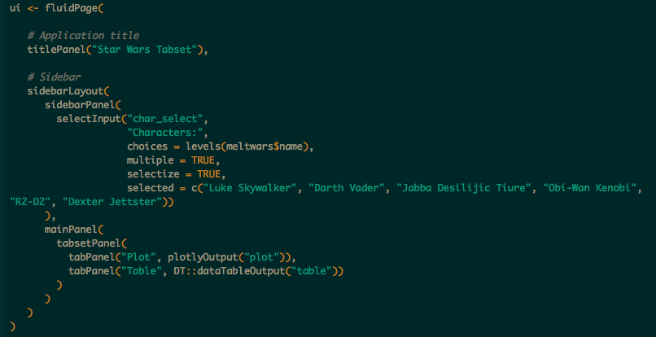

Slide 10
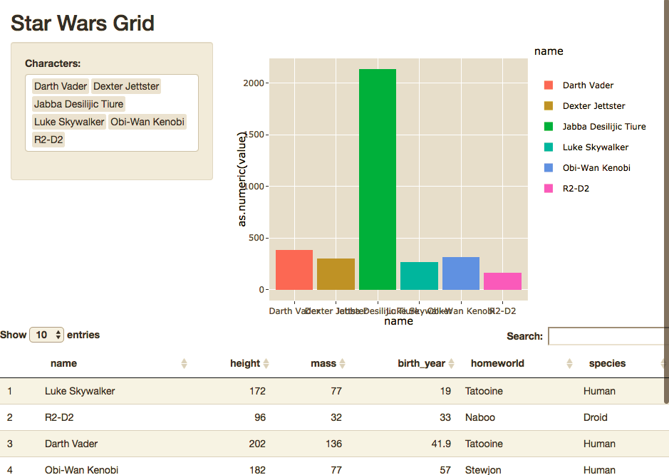
Grid

Slide 11
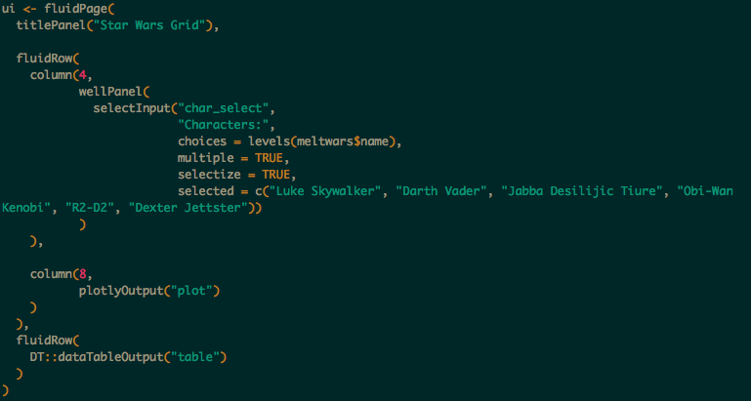

Slide 12
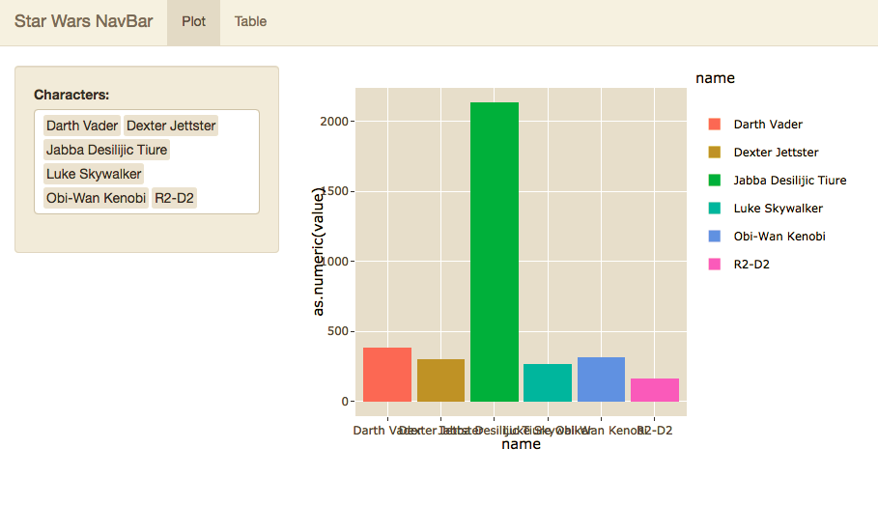
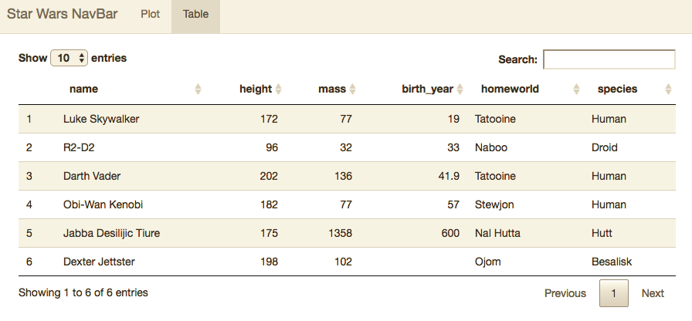
NavBar

Slide 13
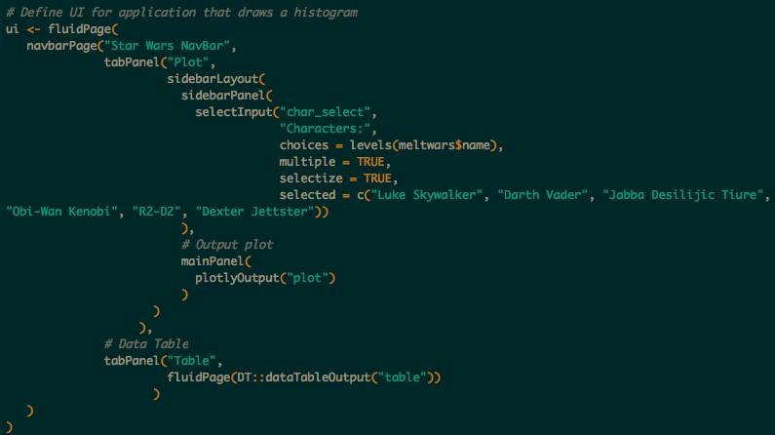

Slide 14
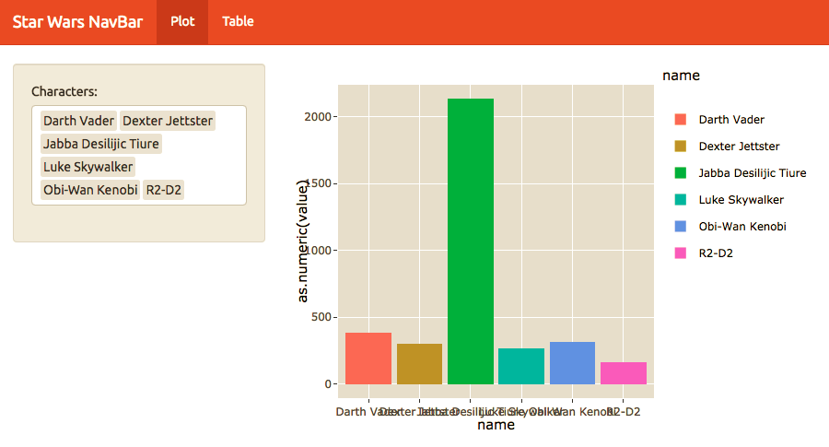

Custom Theme

Slide 15
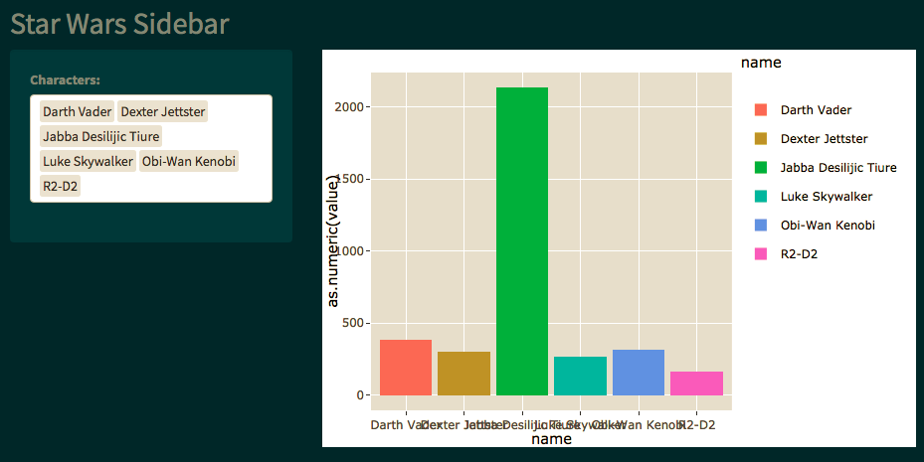

Custom Themes

Slide 16
Basic Concepts of Shiny apps
Intro to Server

Slide 17
Introduction to Server Function
Outputs
List of functions called in the UI which generates plots, tables and other objects.
Will regenerate whenever dependent inputs are changed, or based off of required action in UI.
Shiny Apps will display from any graphics package including;
ggplot2
plotly
DT
LeafletR
ggvis
googleVis
wordcloud2
d3heatmap
dygraphs
ggmap
highcharter
rgl
DiagrammeR
rCharts

Slide 18
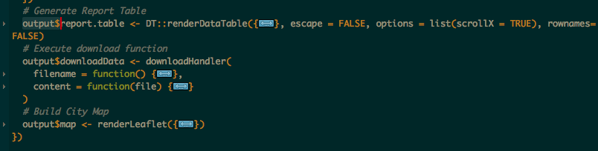
Saving Outputs
Output is a list which you build onto as you create your visuals
Each entry in the list is called in the UI by the name saved.
Example:
The three outputs below are called by “report.table”, “downloadData” and “map” respectively.
Otherwise these images work just like anything created in an RMarkdown document

Slide 19
REVIEW
Shiny Apps are made of up of three arguments.
Ui
Server
There are numerous layout selections and combinations
To easily style your map you can use custom or free css bootstraps
Outputs are functions which generate the desired content for the app’s UI

